Slide 1
Adham Ashraf Saeed
Assignment 1 (ERD)

Slide 2
Case 1
A big company has decided to store information about its projects and employees in a database.
The company has wisely chosen to hire you as a database designer.

Slide 3
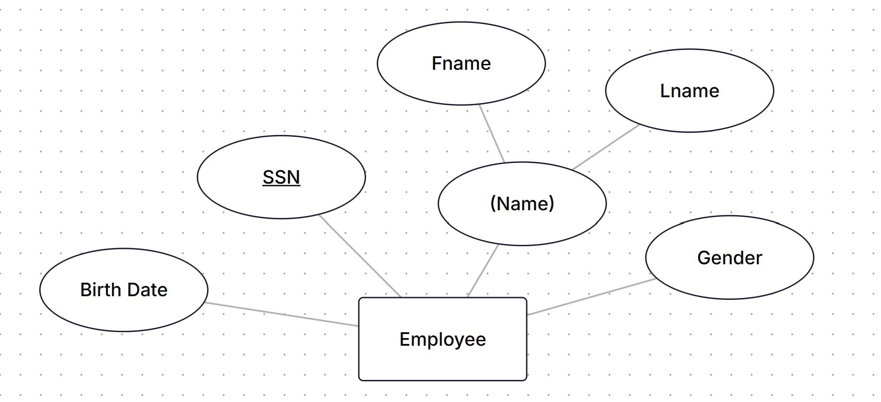
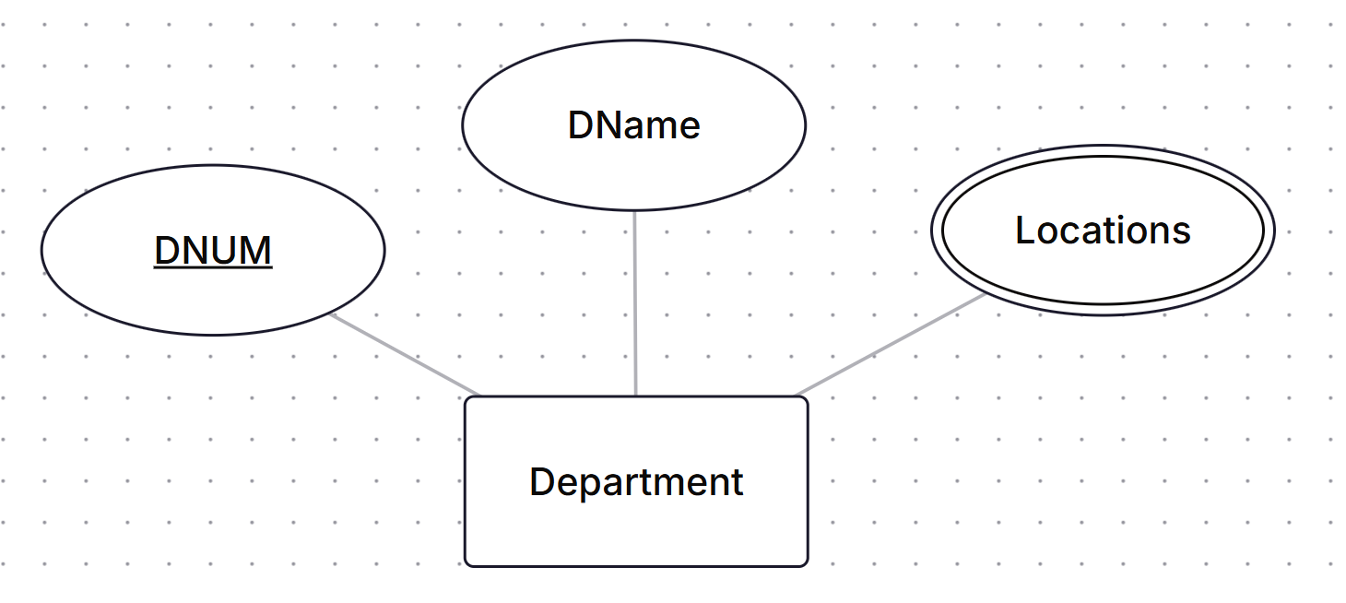
Case 1
Prepare an E-R diagram for this Company according to The following Description:
The company has a number of employees each employee has SSN, Birth Date, Gender and Name which represented as Fname and Lname.
The company has a set of departments each department has a set of attributes DName, DNUM (unique) and locations.

Slide 4
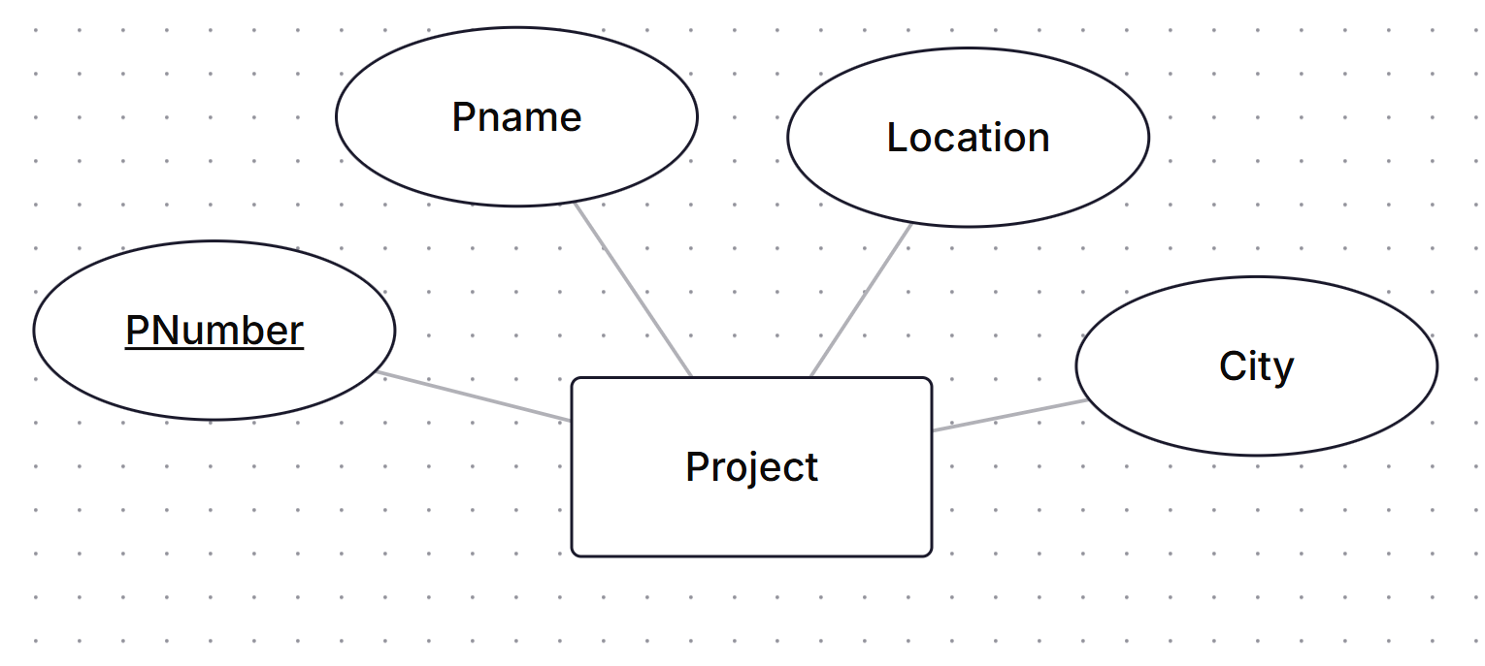
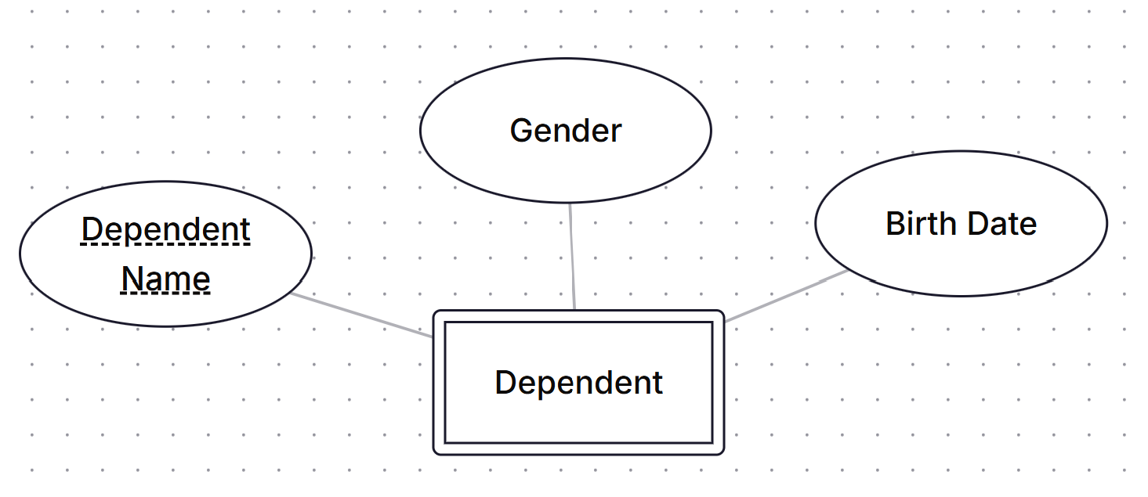
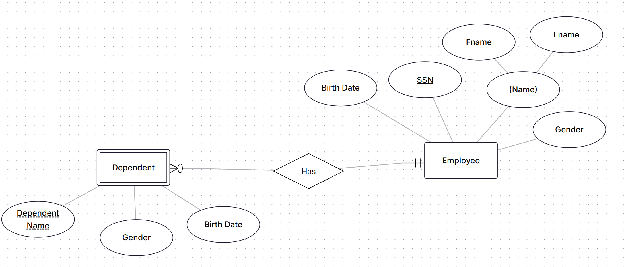
Case 1
Prepare an E-R diagram for this Company according to The following Description:
Employees work in several projects each project has Pname, PNumber as an identifier, Location and City.
Each employee may have a set of dependent; each dependent has Dependent Name (unique), Gender, and Birth Date.
Note: if the employee left the company no needs to store his dependents info

Slide 5
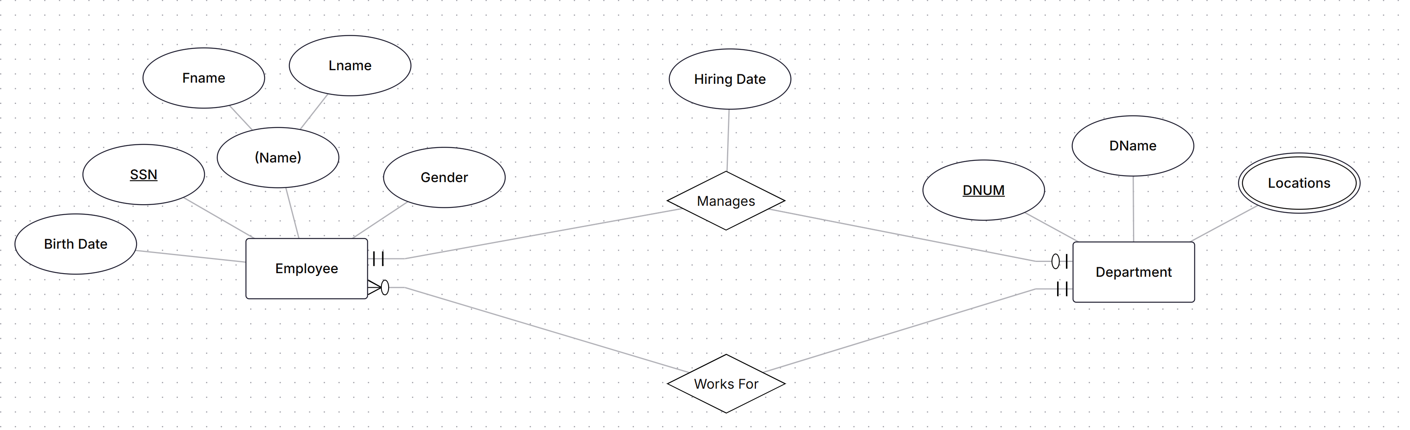
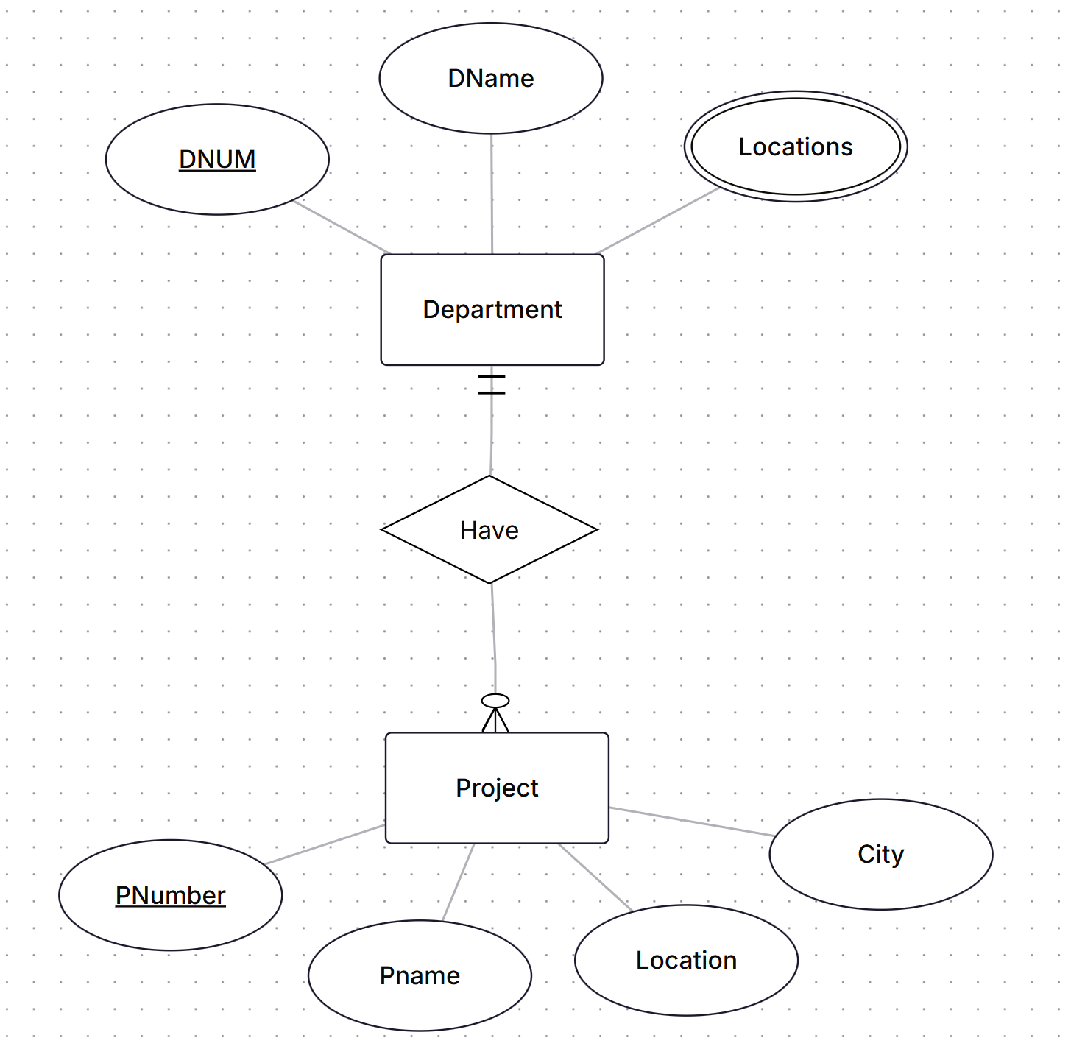
Case 1
Prepare an E-R diagram for this Company according to The following Description:
For each Department, there is always one employee assigned to manage that Department and each manager has a hiring Date
Department may have employees but employee must work on Only One department
Each department may have a set of projects and each project must assigned to one department

Slide 6
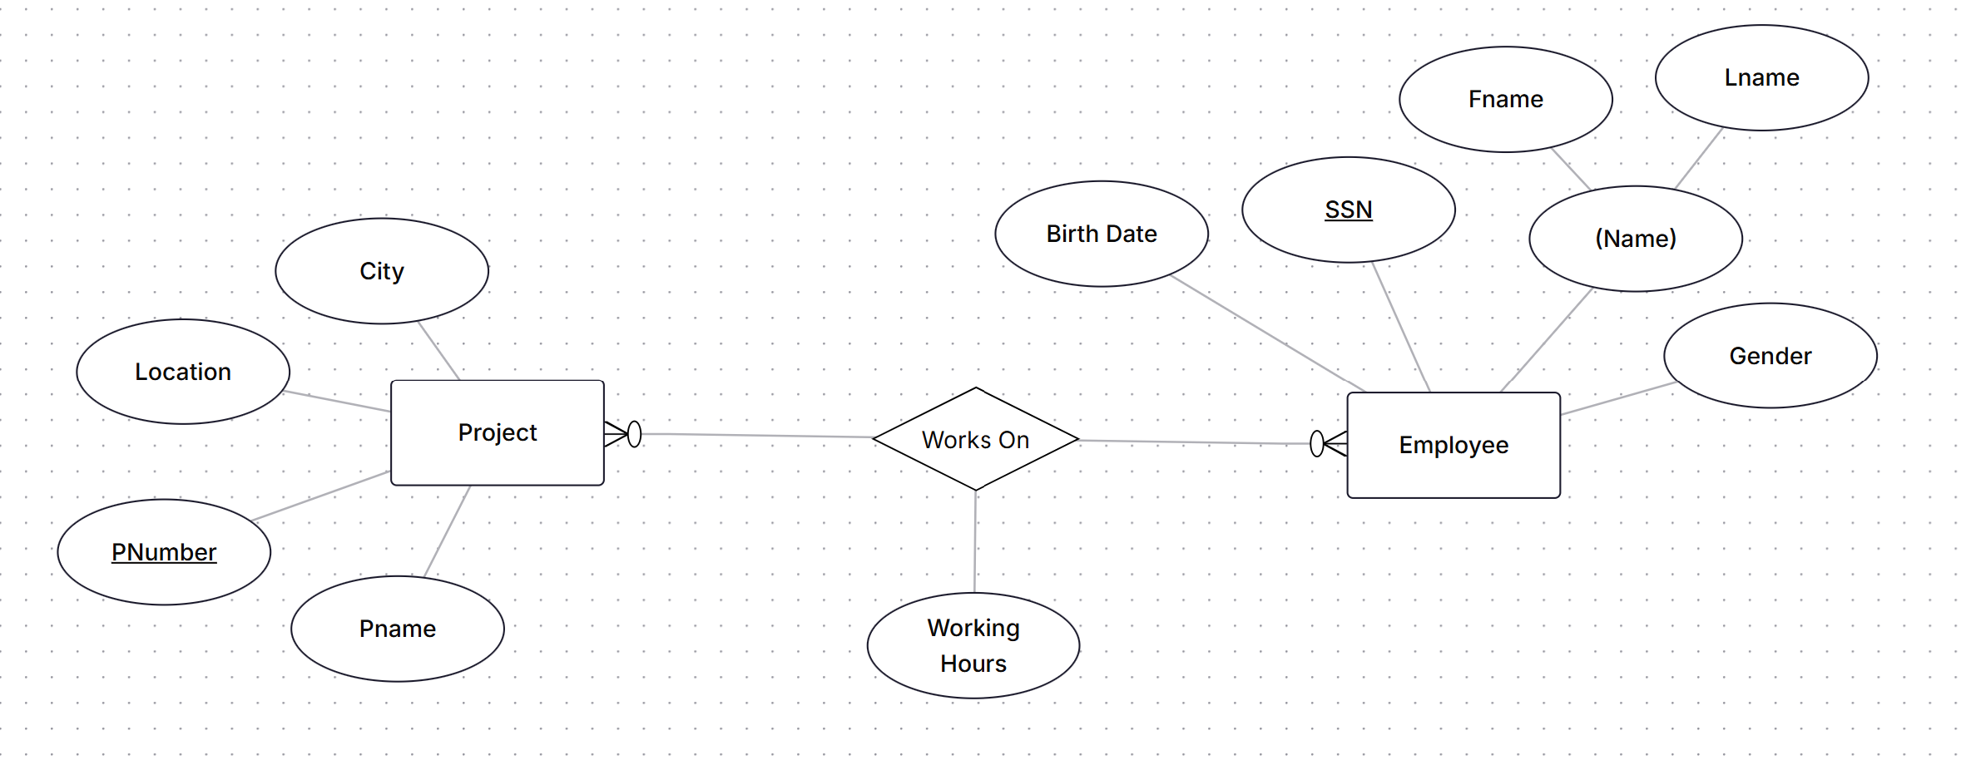
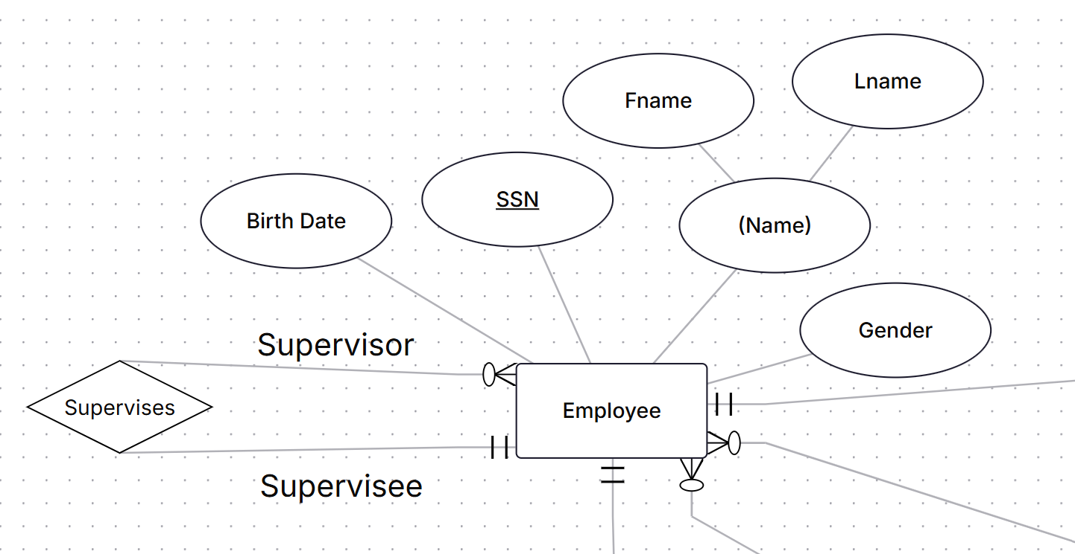
Case 1
Prepare an E-R diagram for this Company according to The following Description:
Employees work in several projects and each project has several employees and each employee has a number of working hours in each project
Each employee has a supervisor

Slide 7
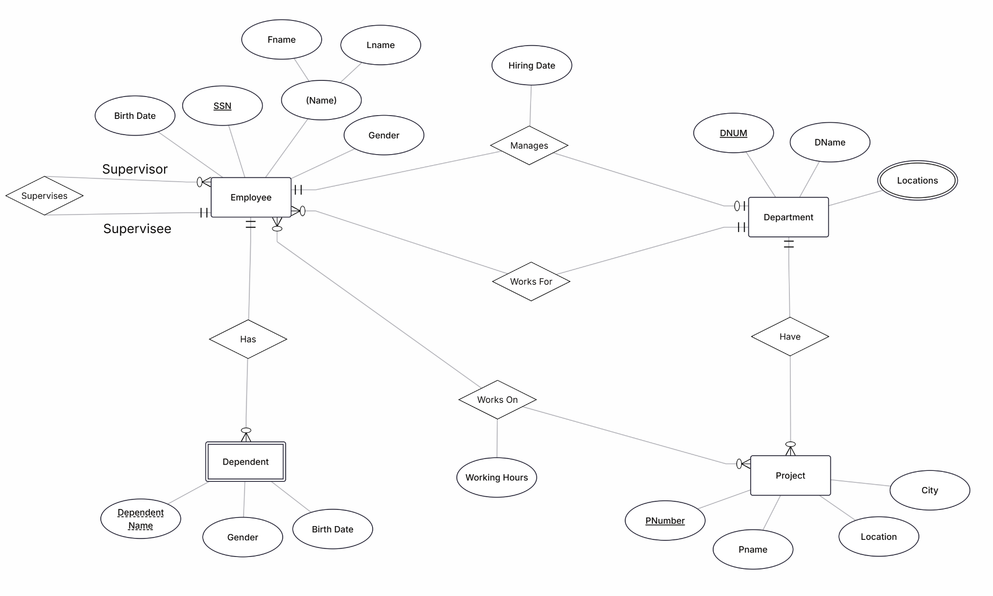
Final ERD

Slide 8
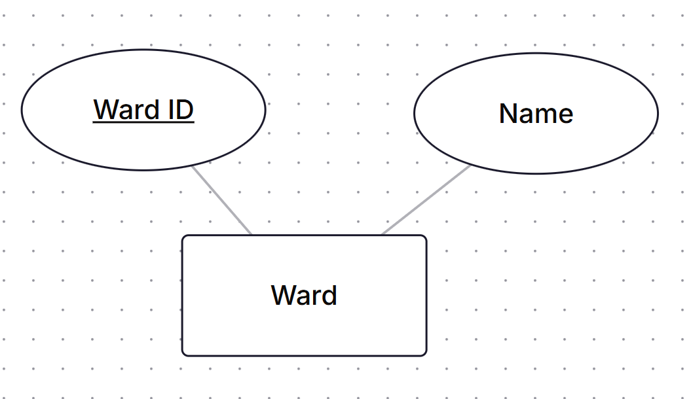
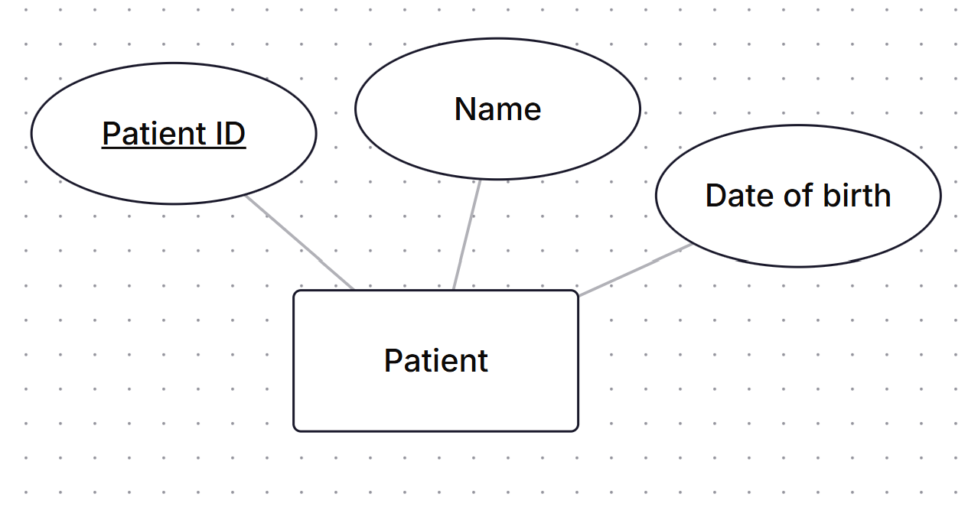
Case 2
A General Hospital consists of a number of specialized wards. Each ward is described by ward_id, Name
The system records the following details about patients: Patient_id, name, Date_Of_Birth

Slide 9
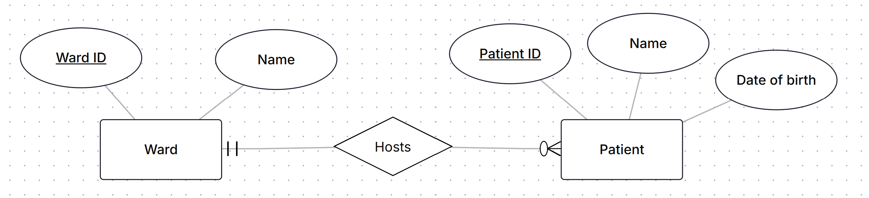
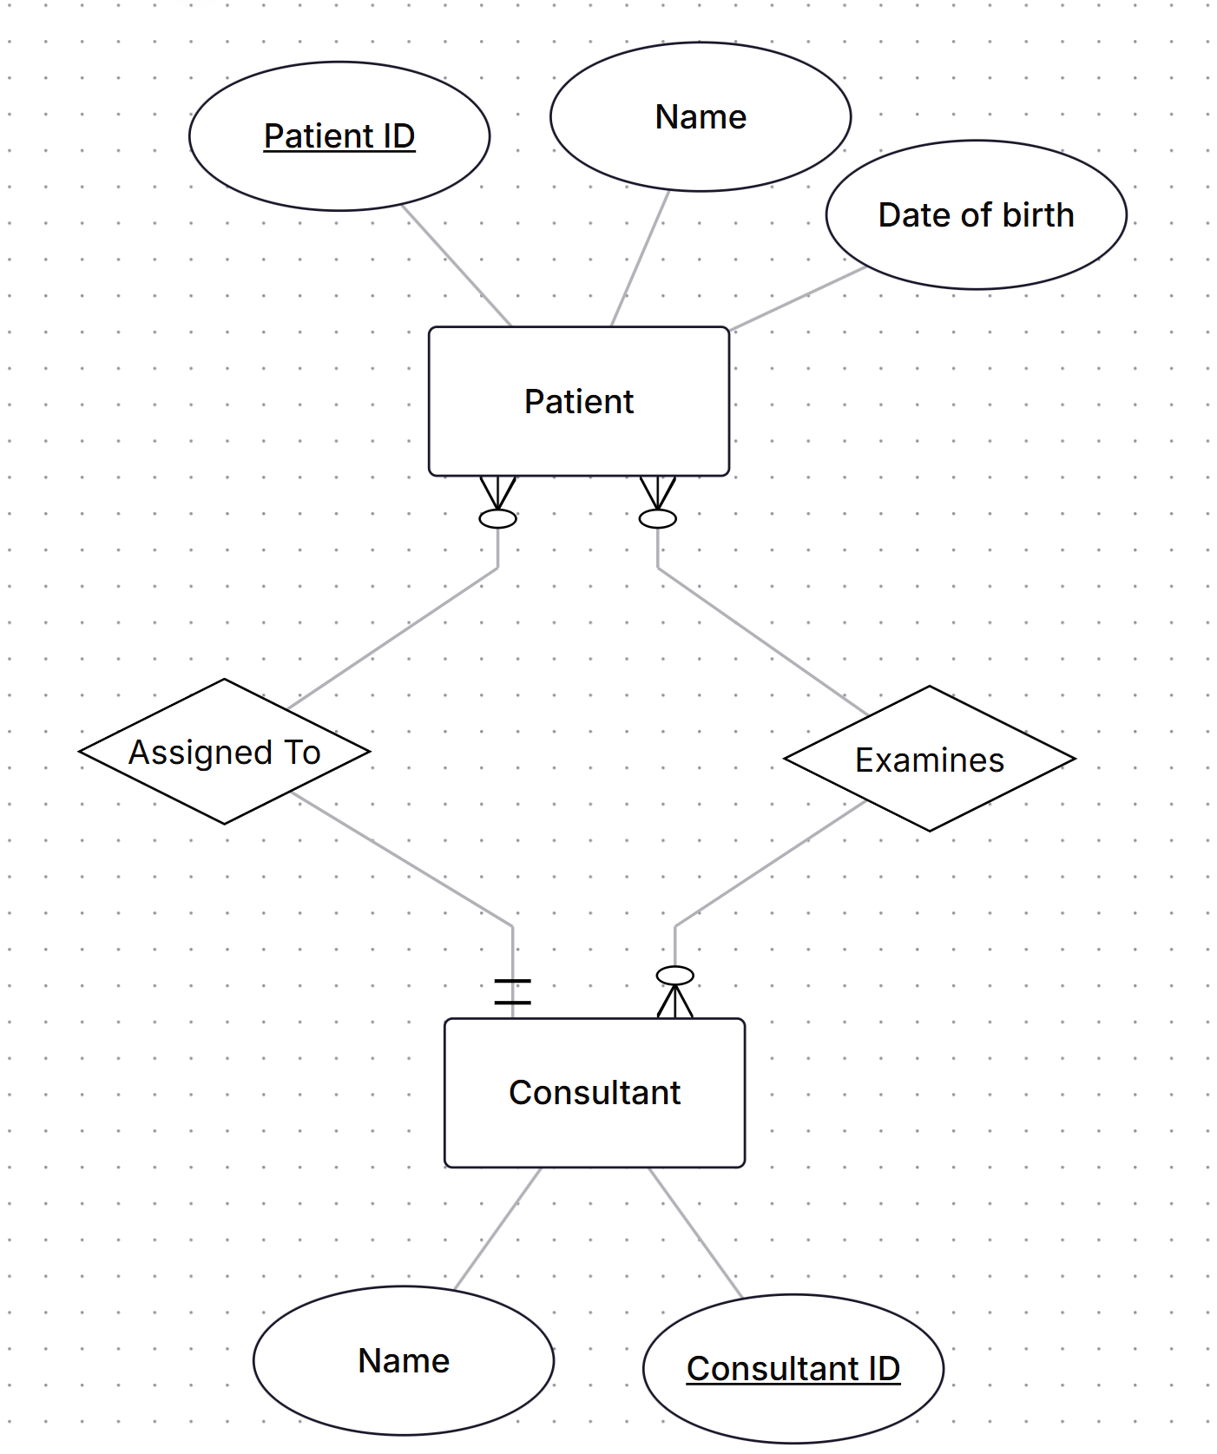
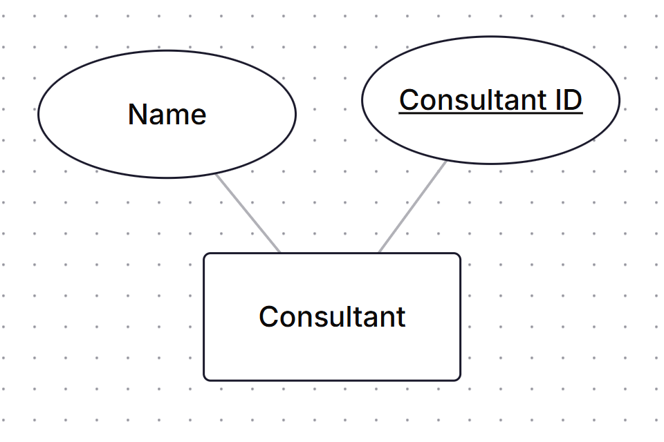
Case 2
Each ward may host more patients and each patient is hosted by only one ward.
Each patient is assigned to one leading consultant but may be examined by other consultants, if required.
Each consultant may be assigned zero or more patients and may examine zero or more patients.
Consultants are described by Consultant_id, Name

Slide 10
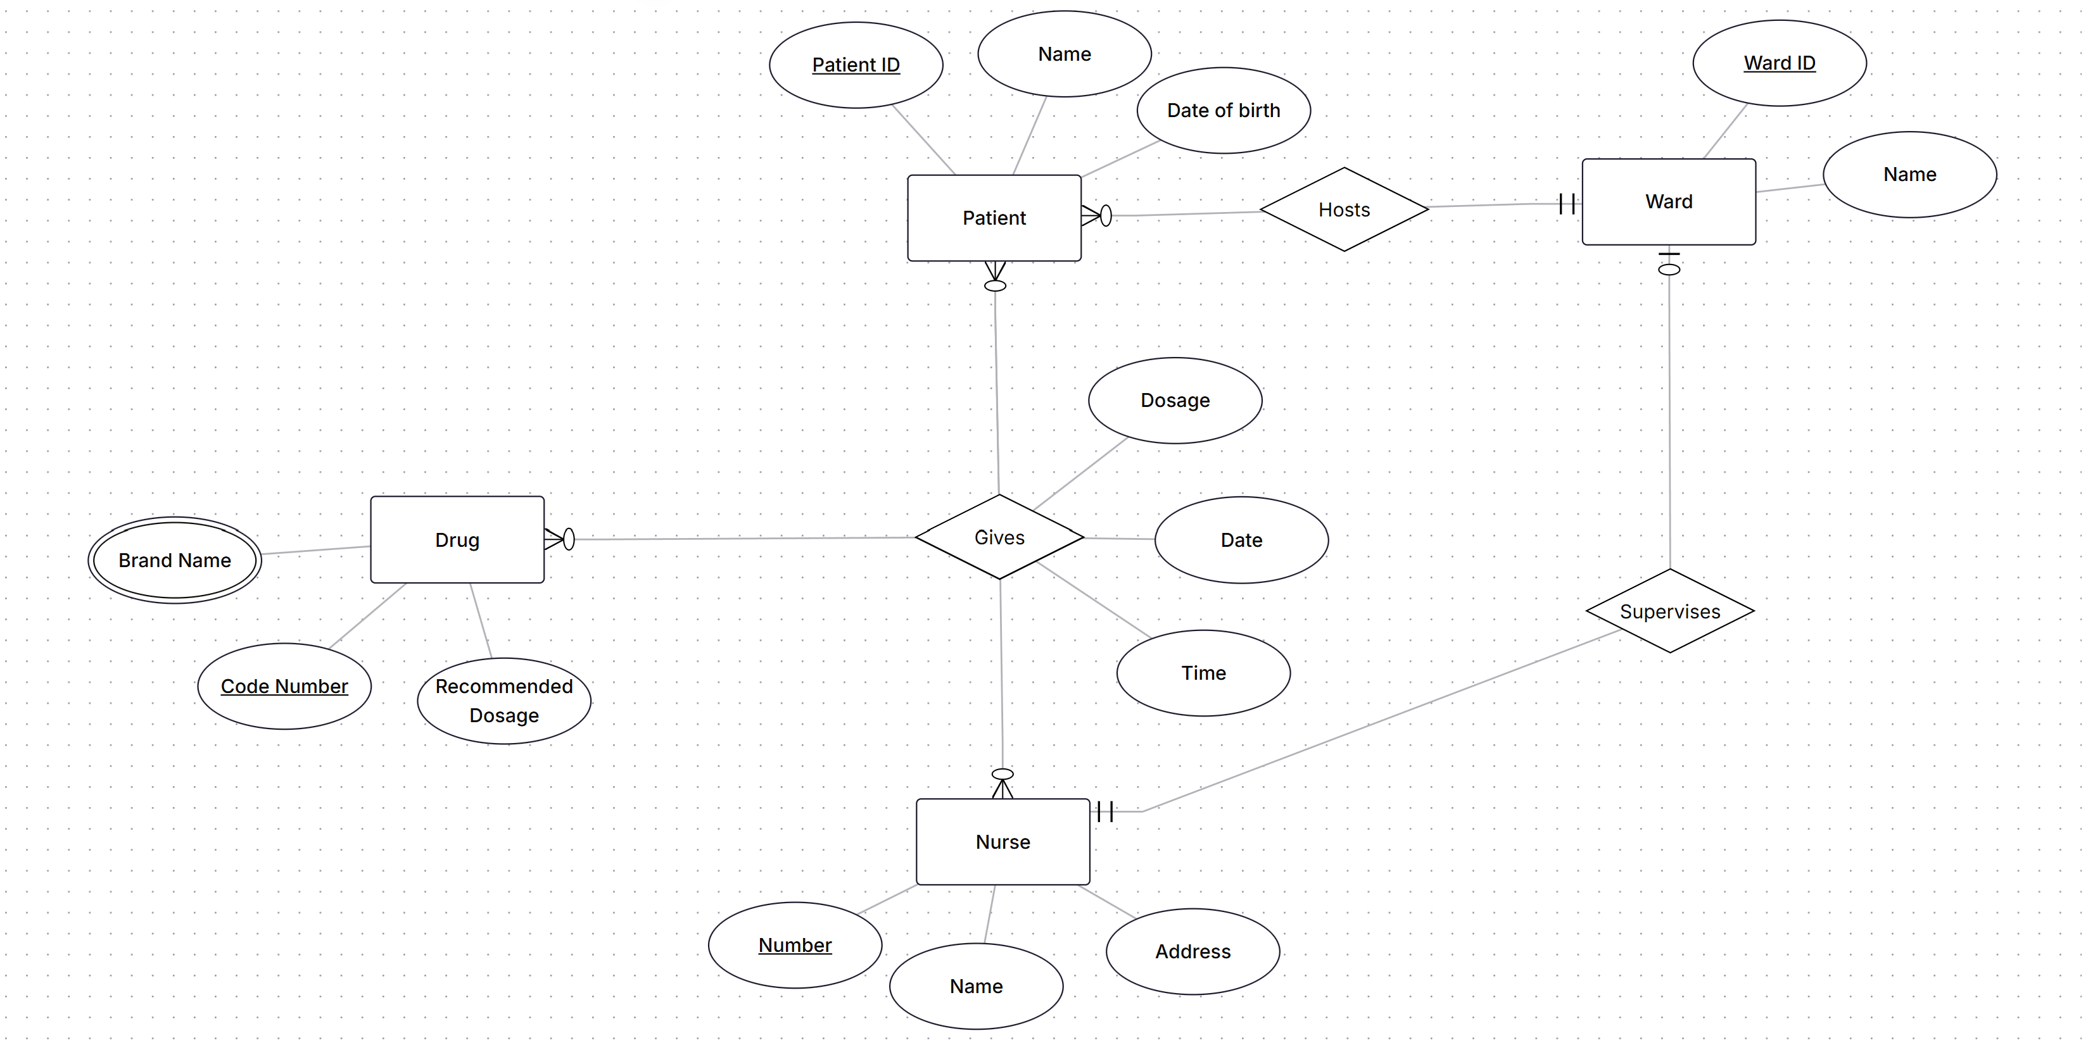
Case 2
The system has to record all required data each time the Nurse gives a patient a certain drug with specified dosage at certain date and time.
Each ward is under supervision of one nurse and a nurse may supervise only one ward.

Slide 11
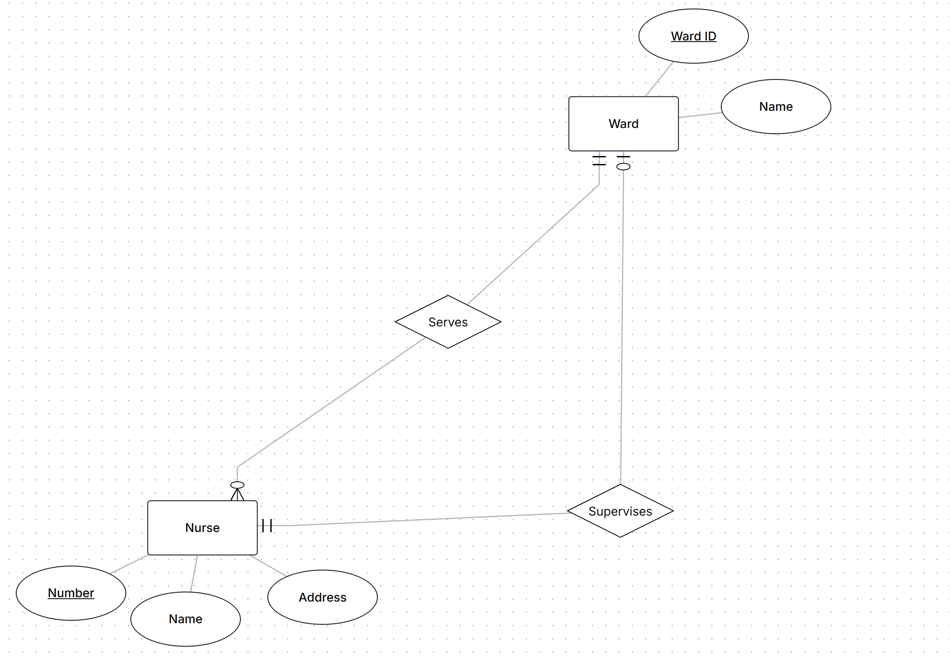
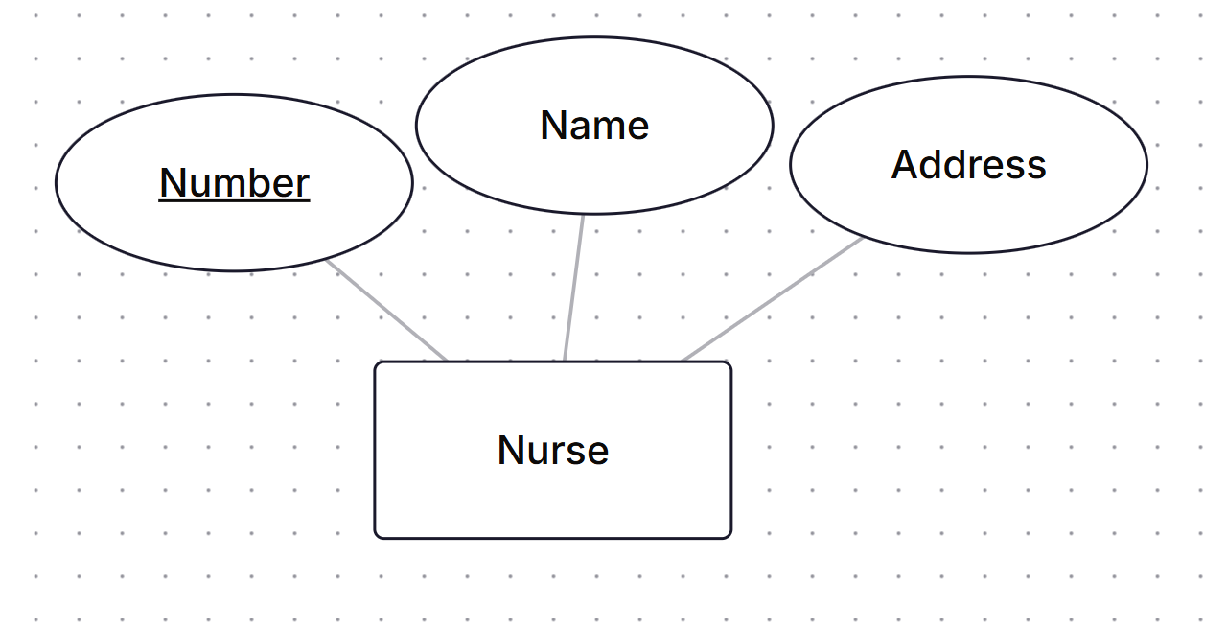
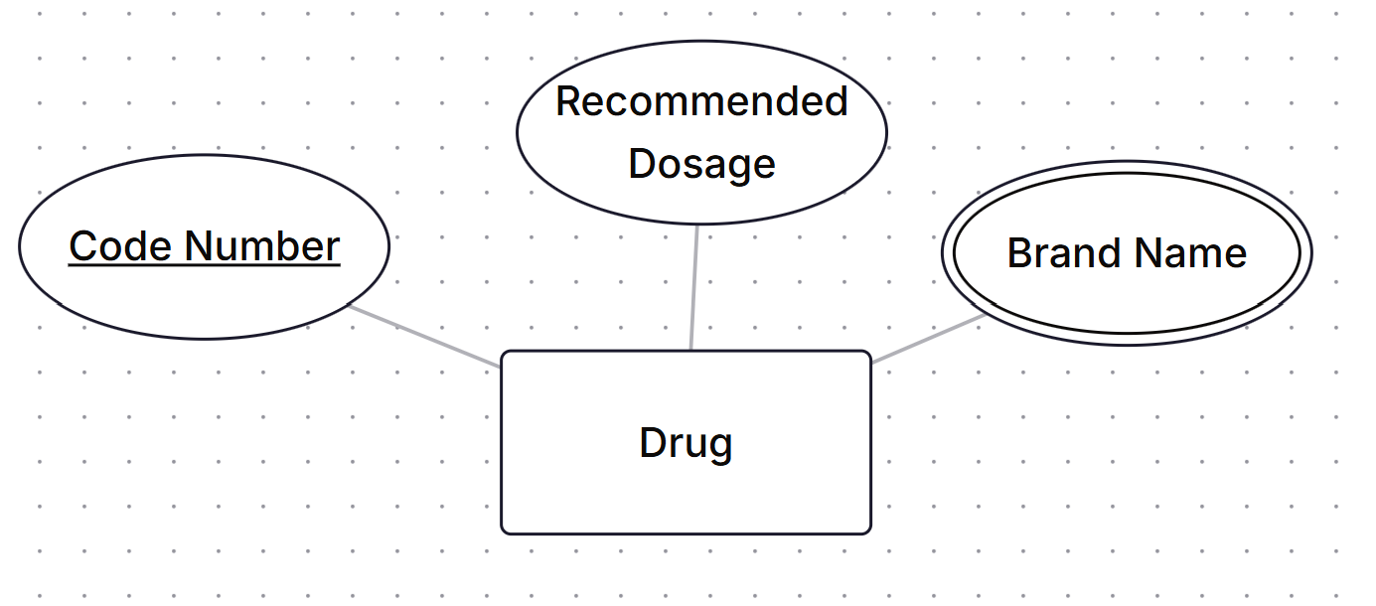
Case 2
Each Nurse must serve in one ward and ward can have many nurses.
Data about the nurse is recorded as her name and her number and her address.
A drug has code number, recommended dosage and more than one brand name.

Slide 12
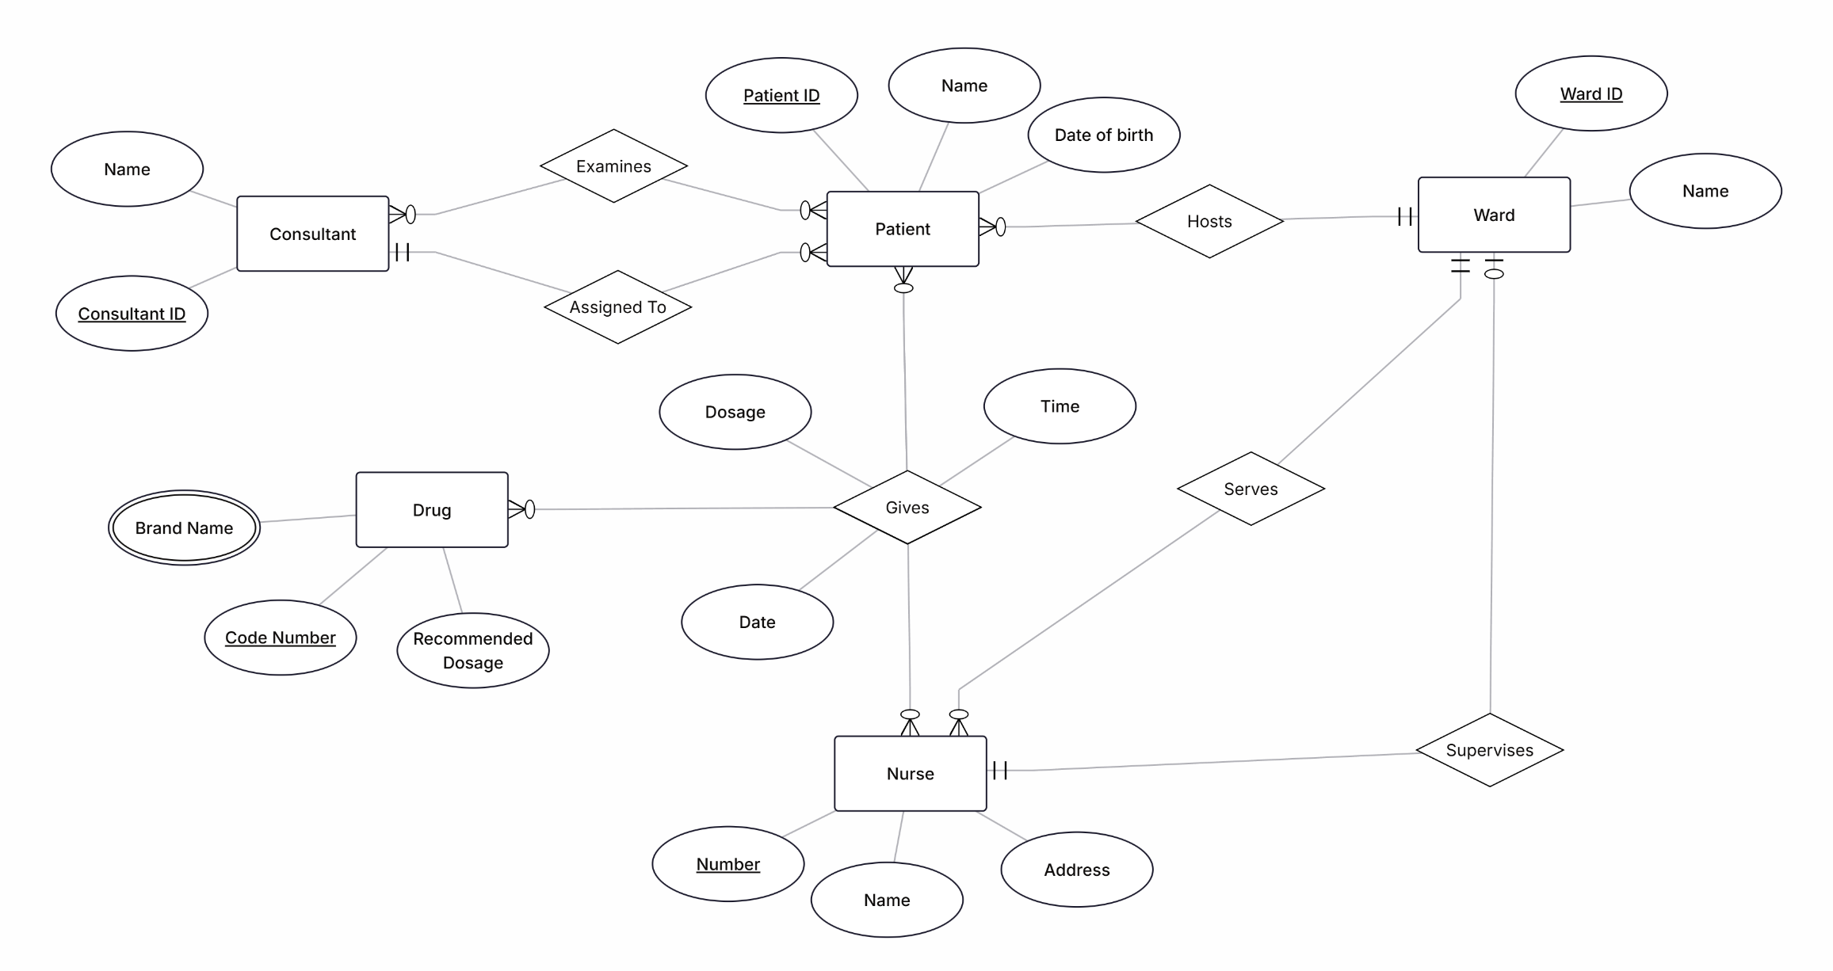
Final ERD

Slide 13
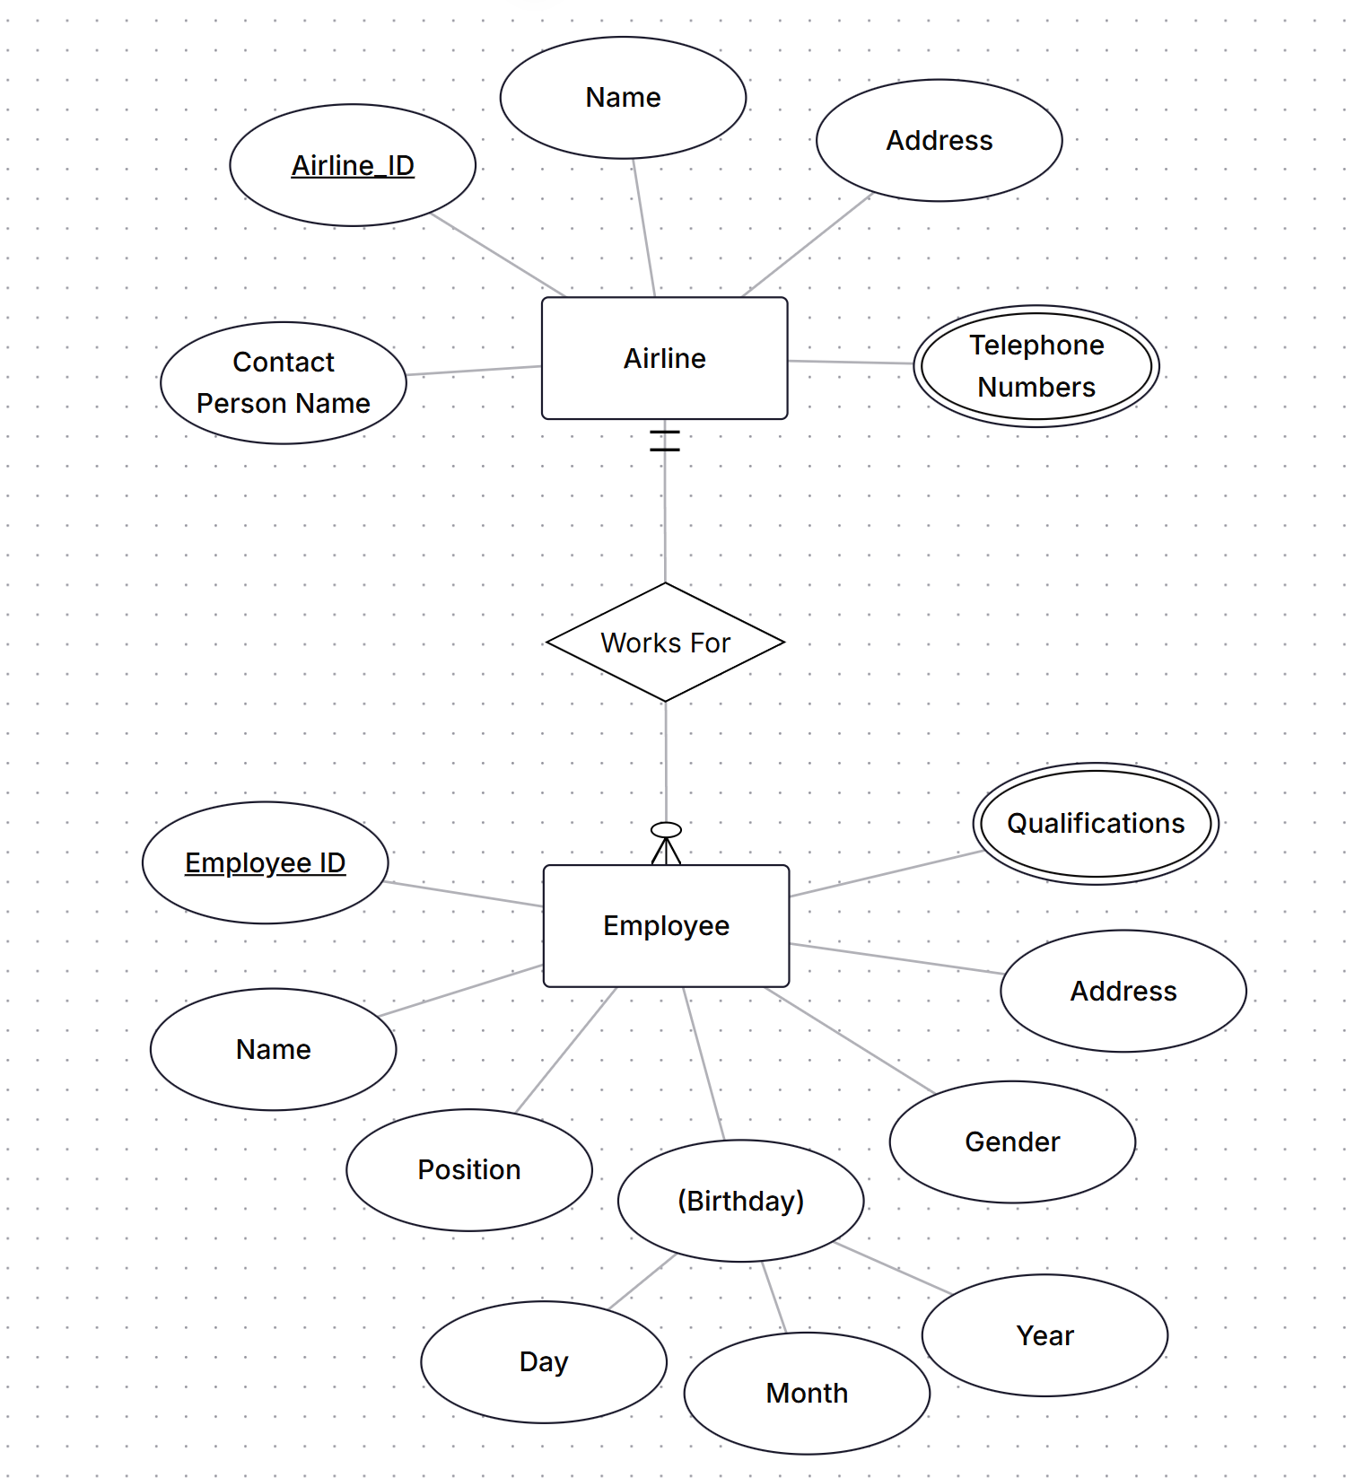
Case 3
Major airlines companies that provide passenger services keep database with lots of information on all airlines.
Each airline has an identification number, name and address, name of the contact person and telephone numbers.
Each employee works in Airline Company has an employee identification number, name, address, birthday recorded as (day, month, year), gender, position with the company, and qualifications.

Slide 14
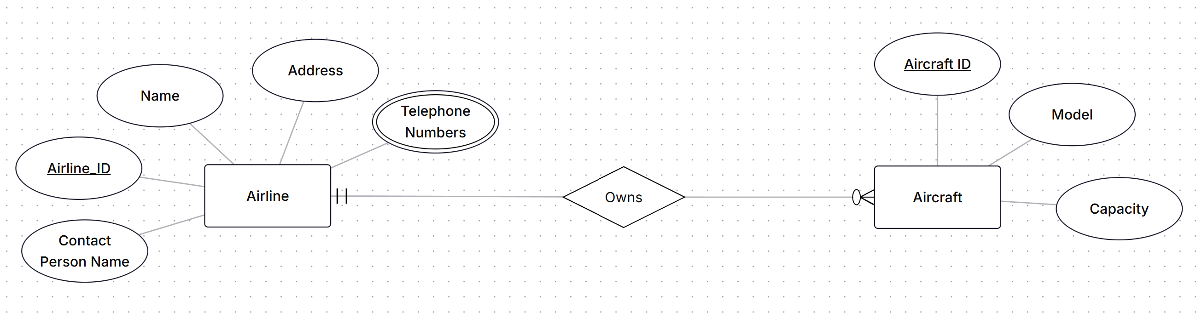
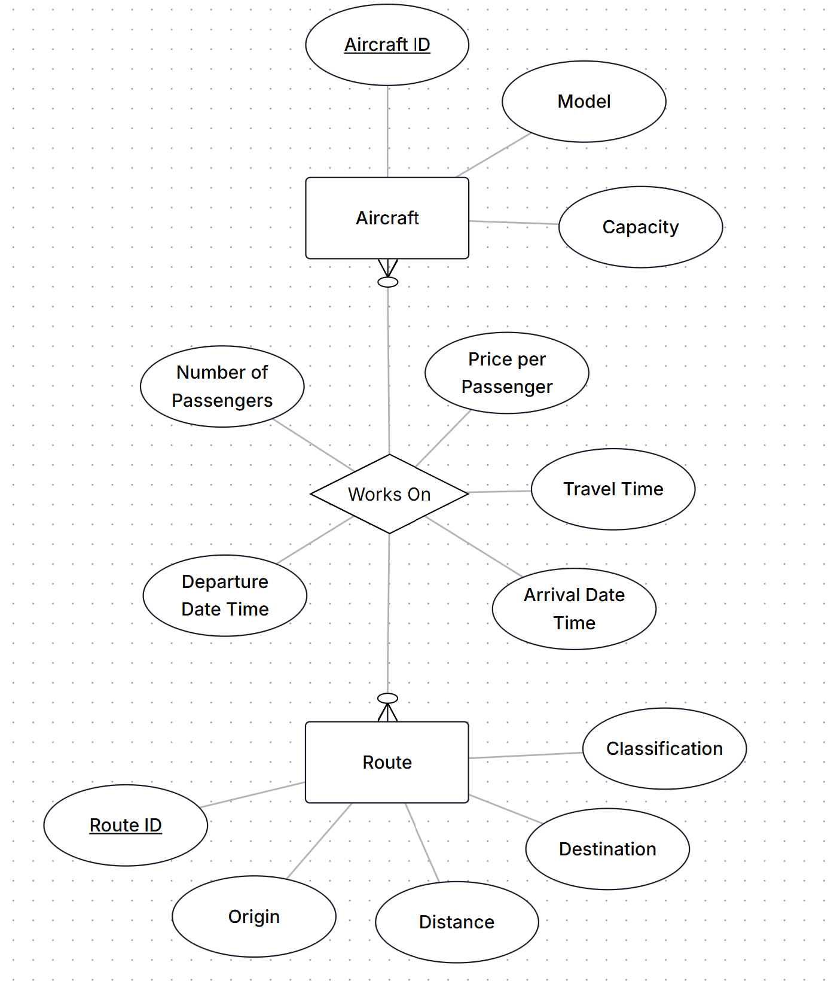
Case 3
Each airline owns different aircrafts. For each aircraft an aircraft identification number, capacity, and model is recorded.
The aircrafts are assigned to different routes. An aircraft can work on more than one route and a route has many aircrafts going on it. Some information as number of passengers, price per passenger, departure date time, arrival date time and the time that aircraft spent in travelling the route are recorded.

Slide 15
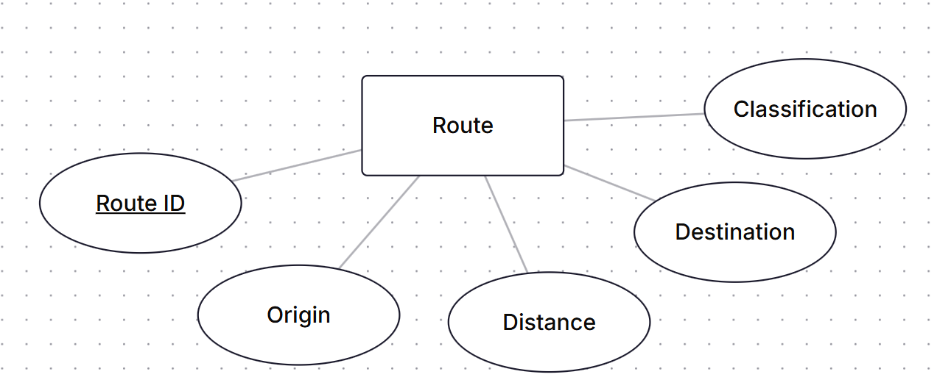
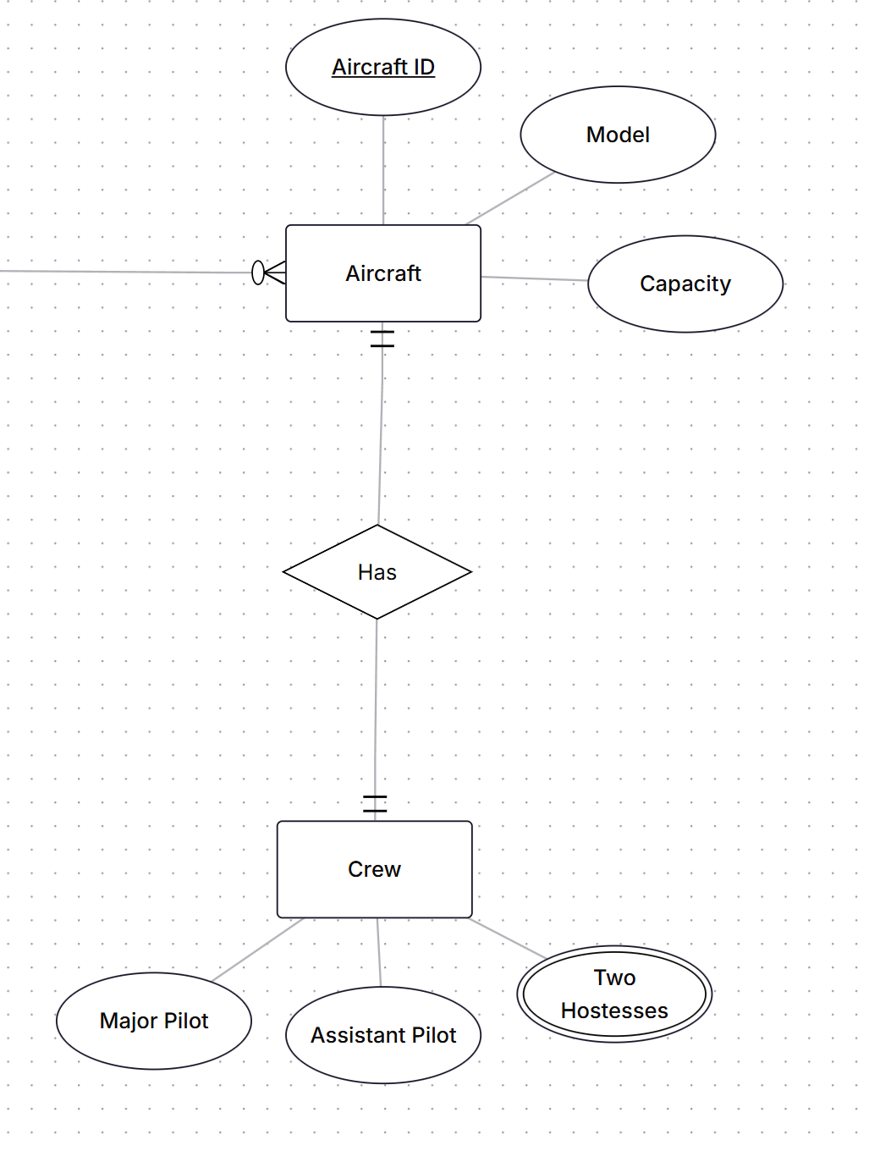
Case 3
Each route has a route identification number, origin, destination, distance,classification (e.g. domestic or international route).
Each aircraft has its own crew (major pilot, assistant pilot and two hostesses), the aircraft crew not stored as employee. Each crew is assigned to only one aircraft.

Slide 16
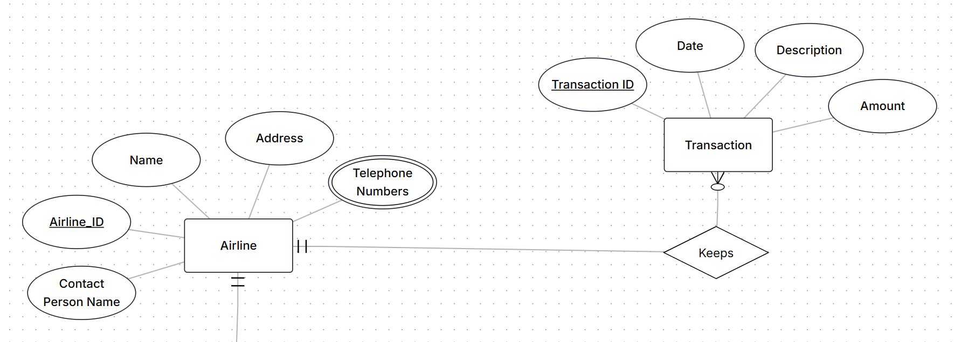
Case 3
Each airline keeps information about their buy/sell transactions (for example selling an airplane ticket is a sell transaction, paying for maintenance is a buy transaction). Each transaction has a transaction identification number, date, description, and amount of money paid/received.

Slide 17
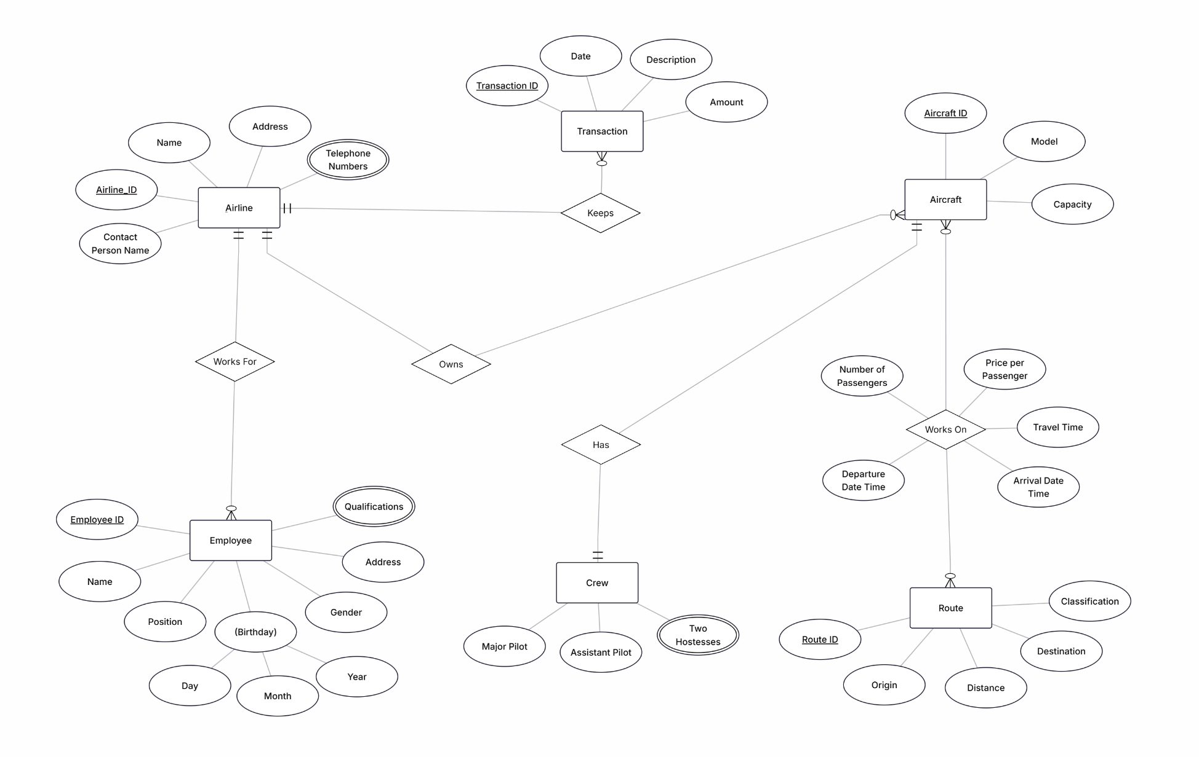
Final ERD

